Slide 1
Naan Mudhalvan
Salesforce Developer
PROJECT TITLE: BUILD A EMPLOYEE TRAVEL APPROVAL APPLICATION FOR CORPORATES
TEAM MEMBERS
GOWSIKA DEVI S T (611220205008)
HARISH S (611220205009) (TEAM LEAD)
PAVISH S (611220205023)
VIGNAYA G S (611220205045)
COURSE INSTRUCTOR
Mr.R.AYYAPPAN
COLLEGE SPOC
Mr.T.KARTHIKEYAN

Slide 2
PROJECT GOAL
Building an Employee Travel Approval Application for corporate use within the Salesforce platform involves a multi-faceted approach, starting with requirements gathering to define user roles and workflows.
This Project helps in sending your travel approval requests to your manager in place of emails.
PROJECT DESCRIPTION
Create an eﬃcient employee approval app on the Salesforce platform, streamlining corporate workﬂows & enhancing productivity. Simplify decision-making processes, boost collaboration, and ensure seamless approval cycles for businesses of all sizes.

Slide 3
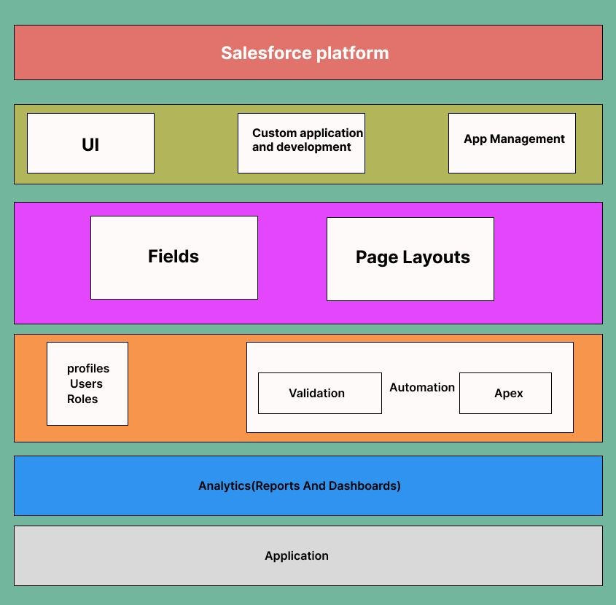
TECHNICAL ARCHITECTURE

Slide 4
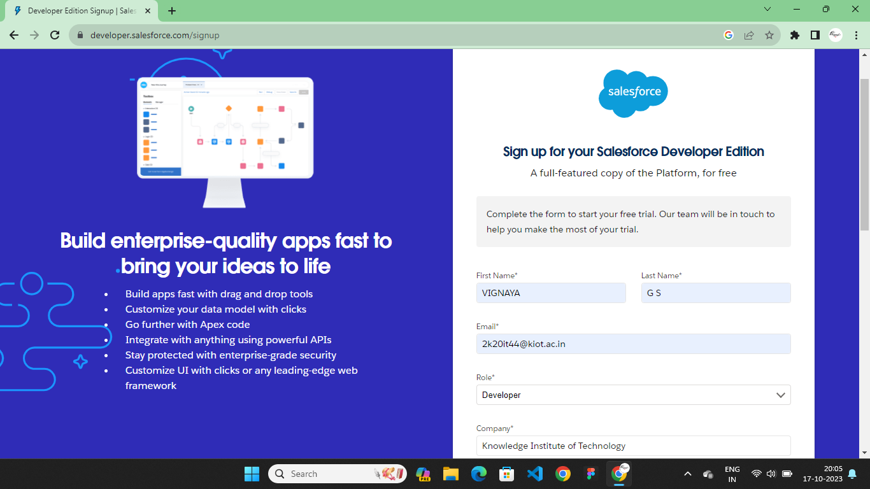
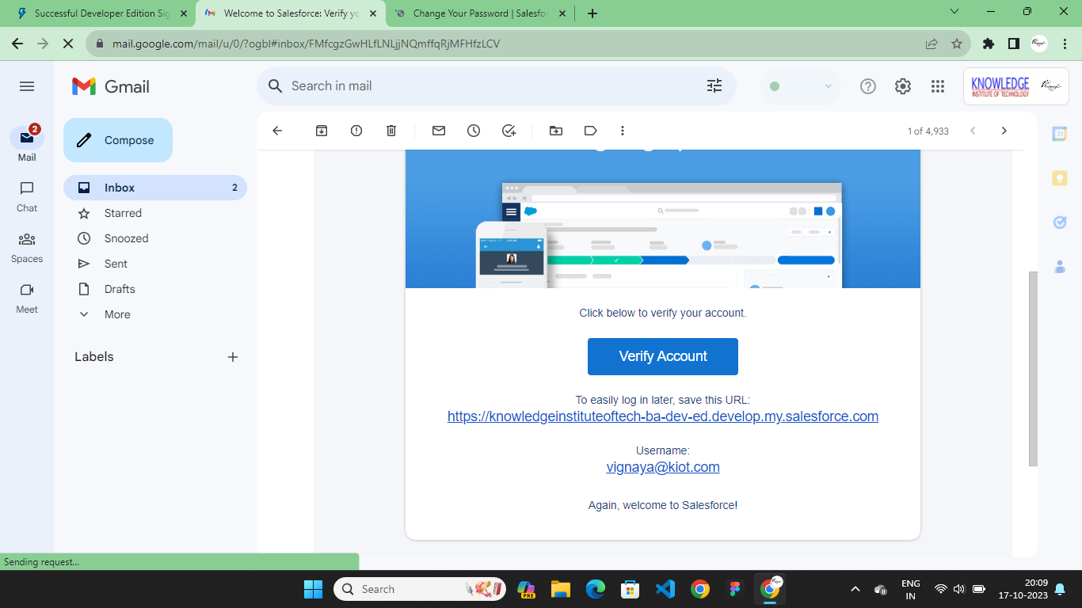
SALESFORCE DEVELOPER ORG

Slide 5
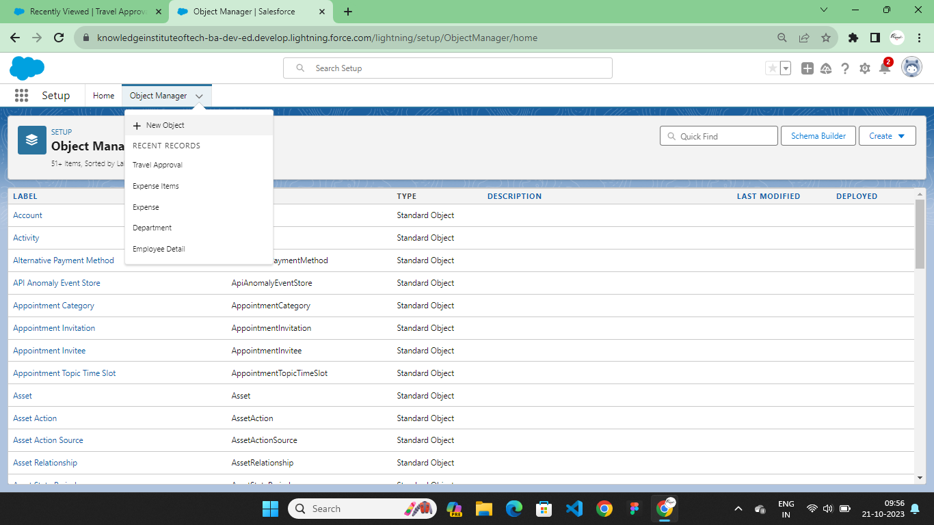
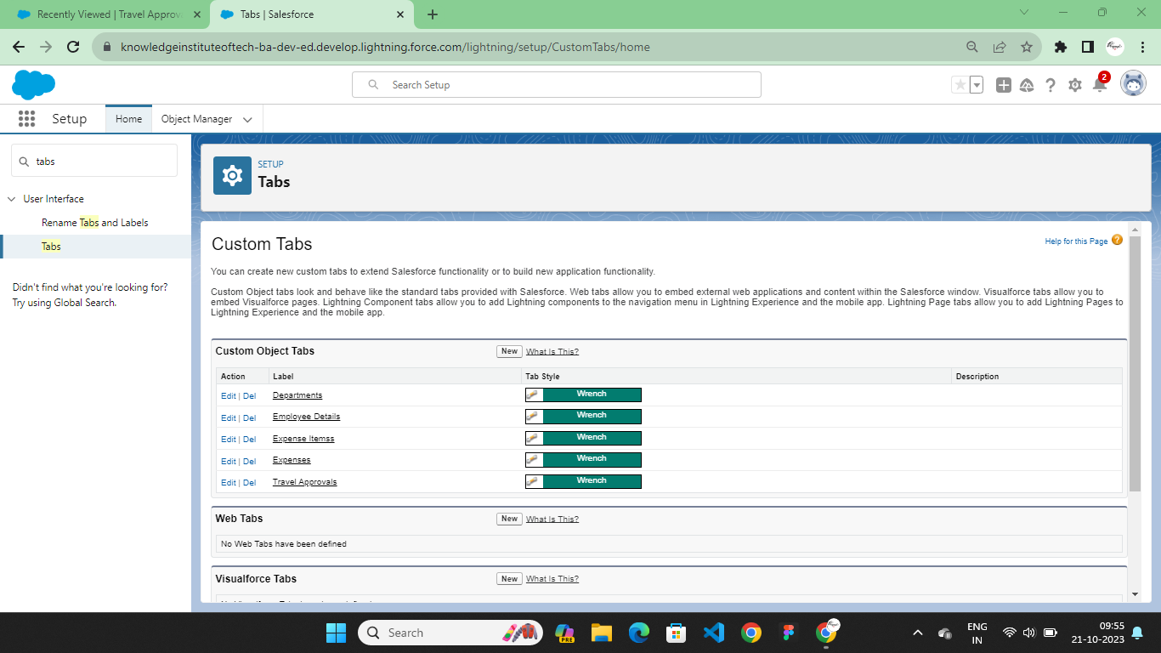
CUSTOM OBJECT CREATION & TABS

Slide 6
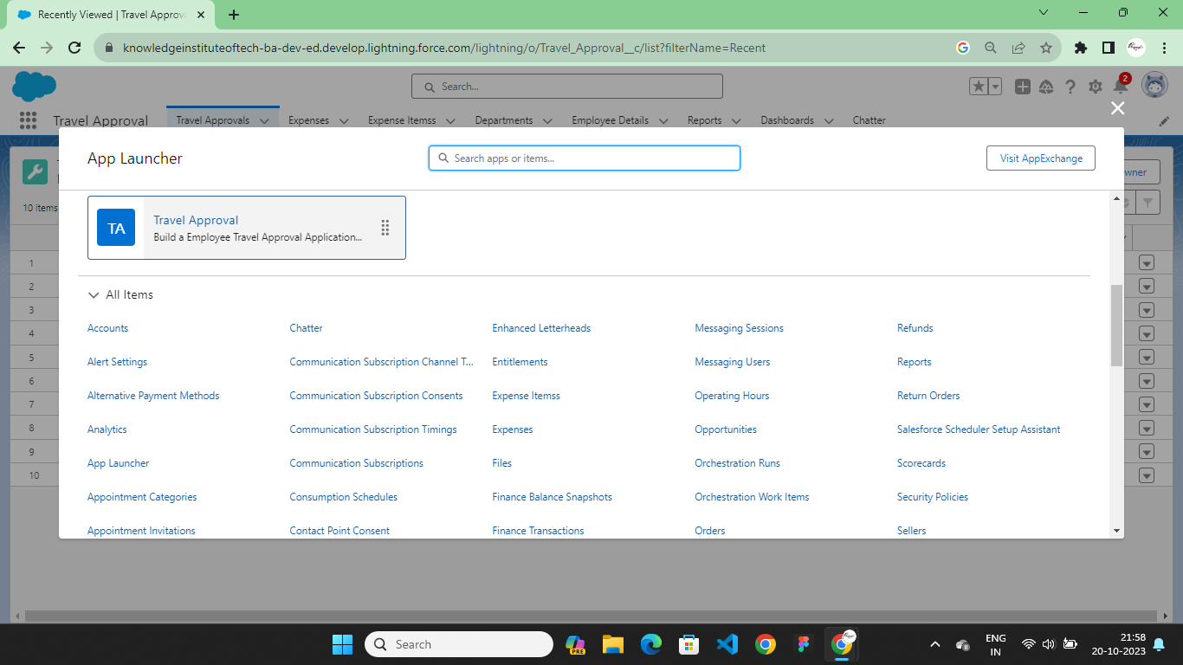
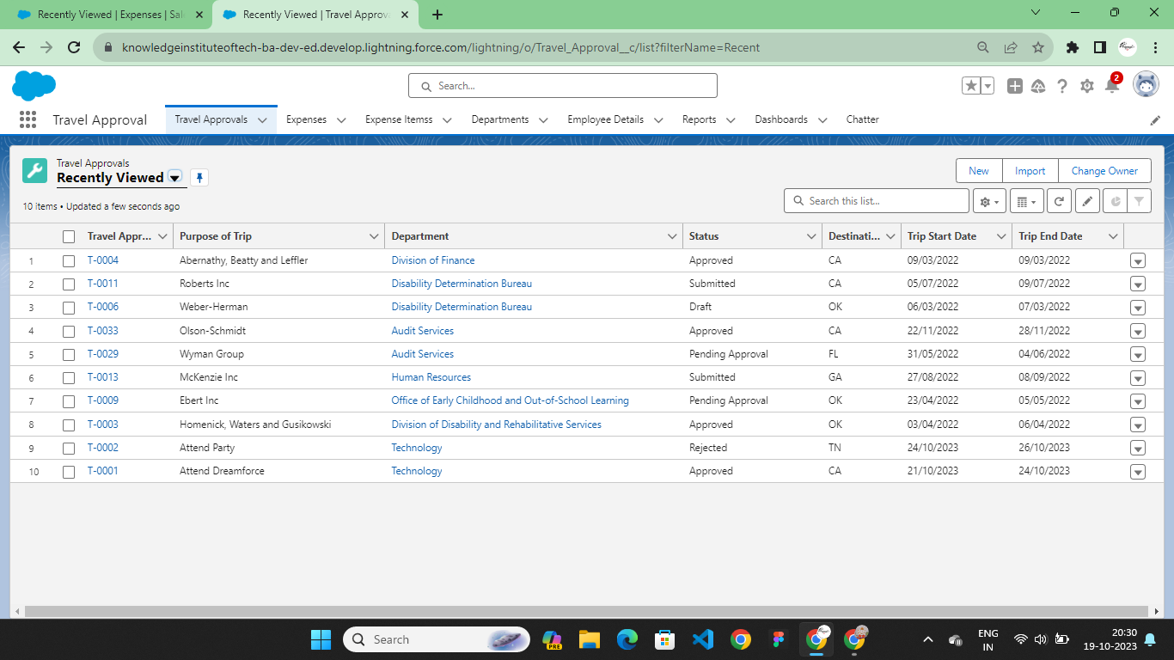
LIGHTNING APP

Slide 7
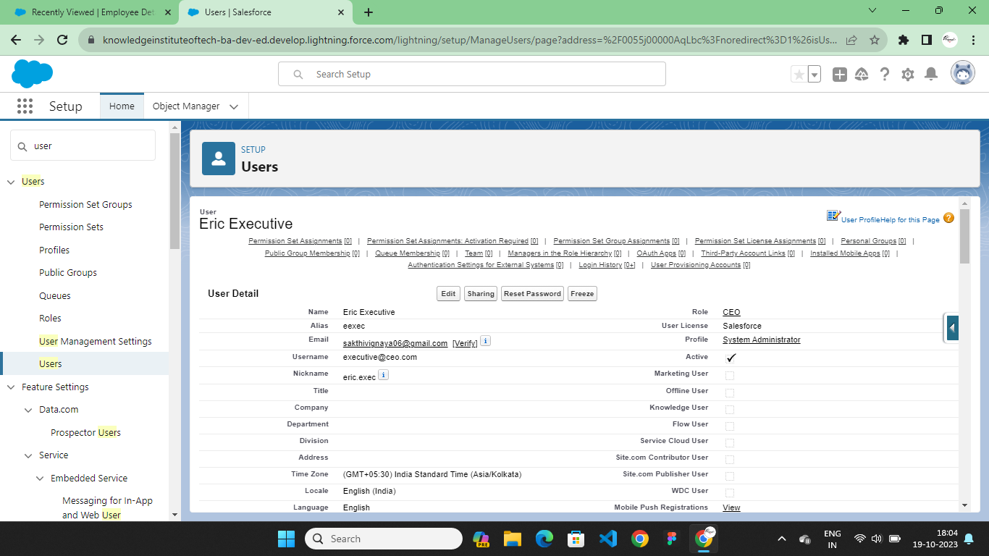
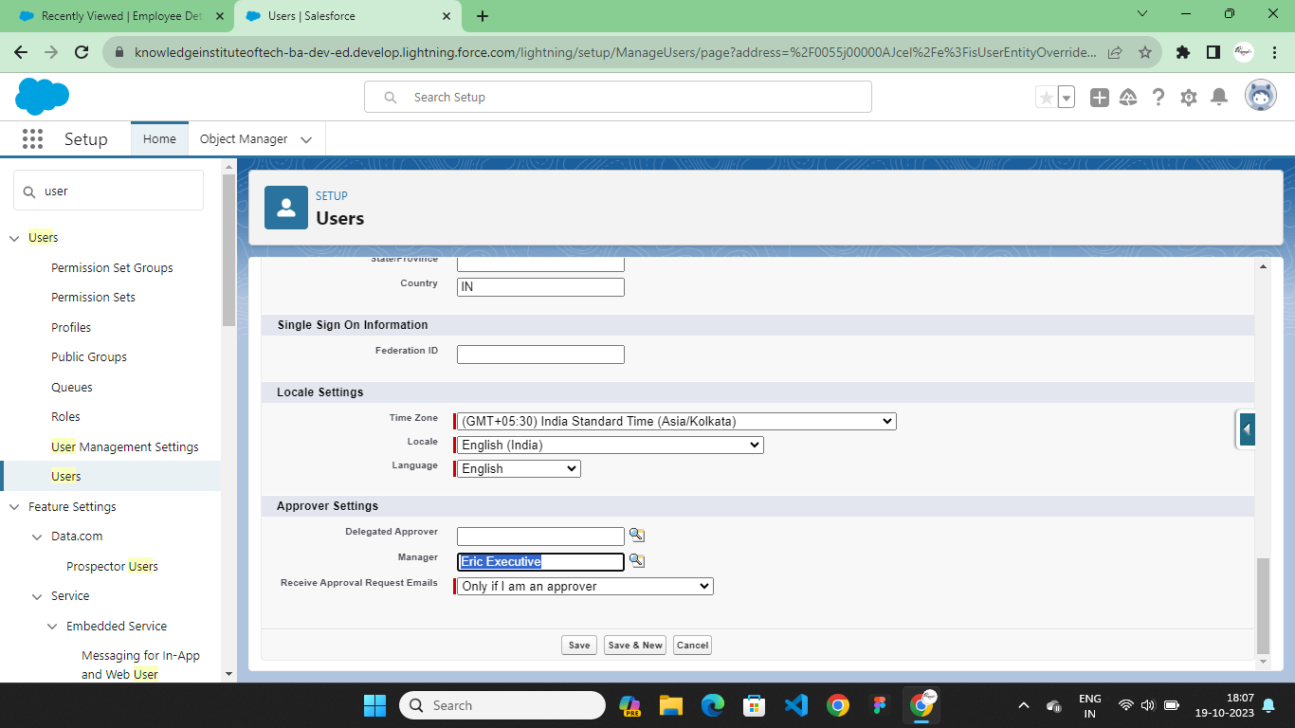
USER CREATION

Slide 8
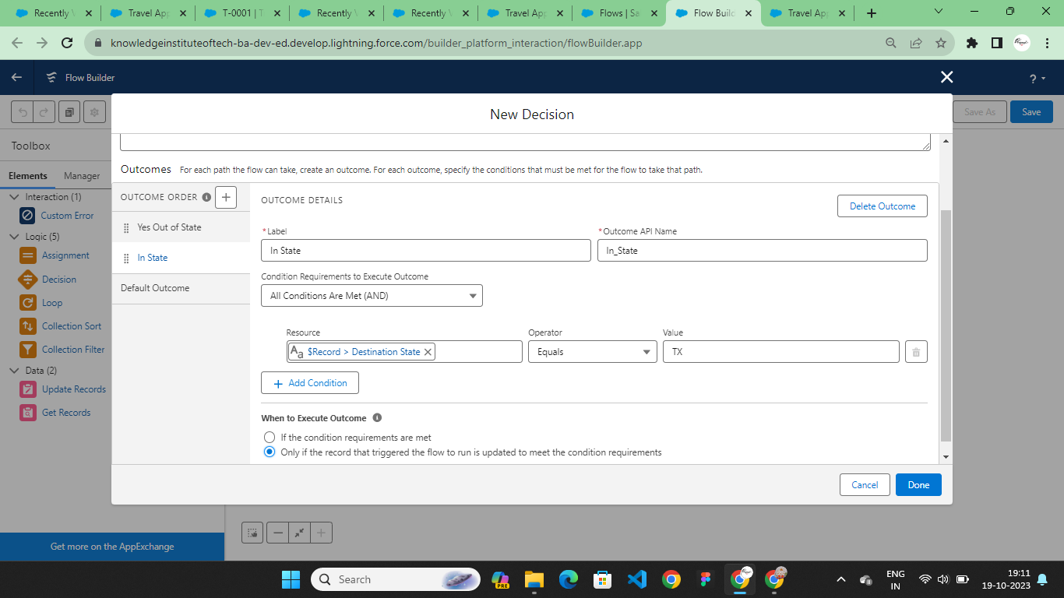
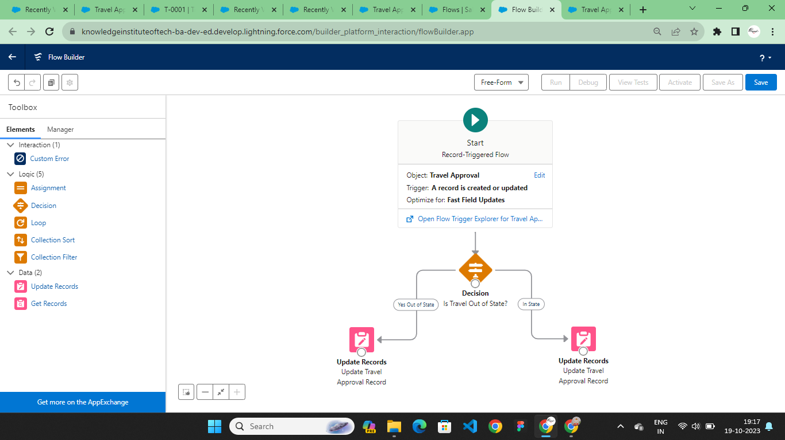
FLOWS

Slide 9
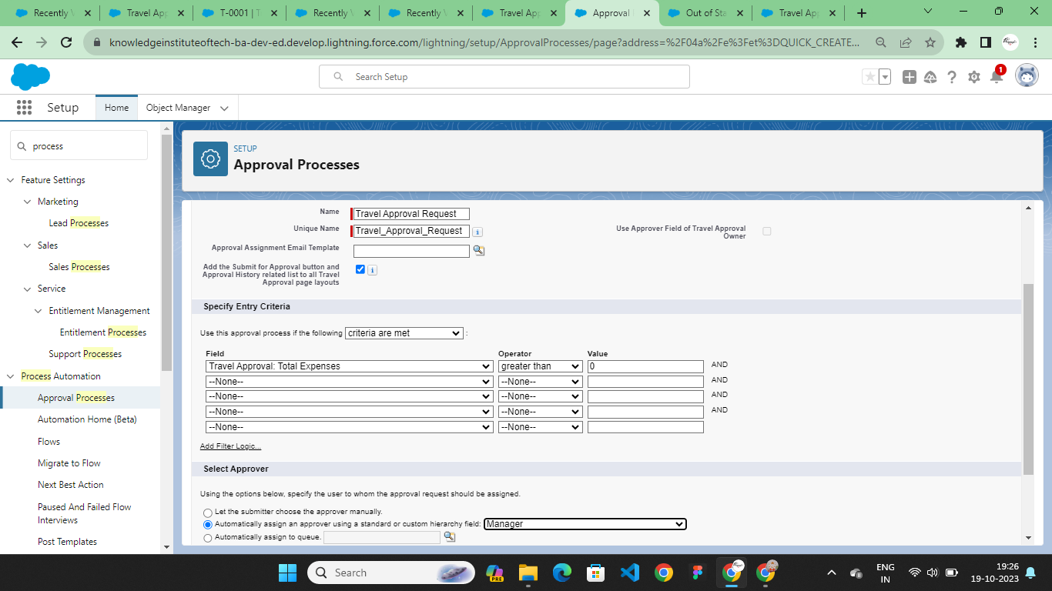
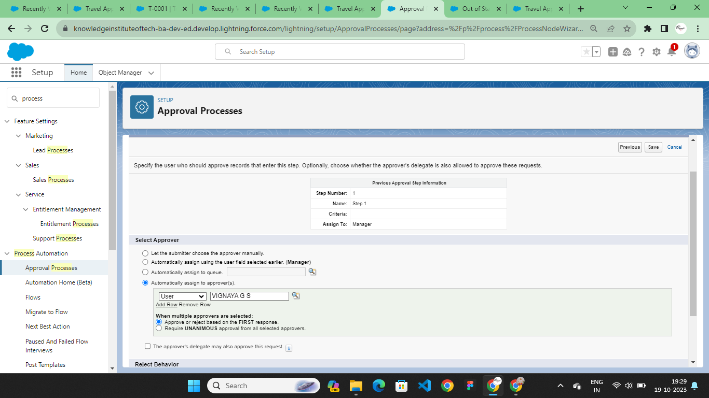
APPROVAL PROCESS

Slide 10
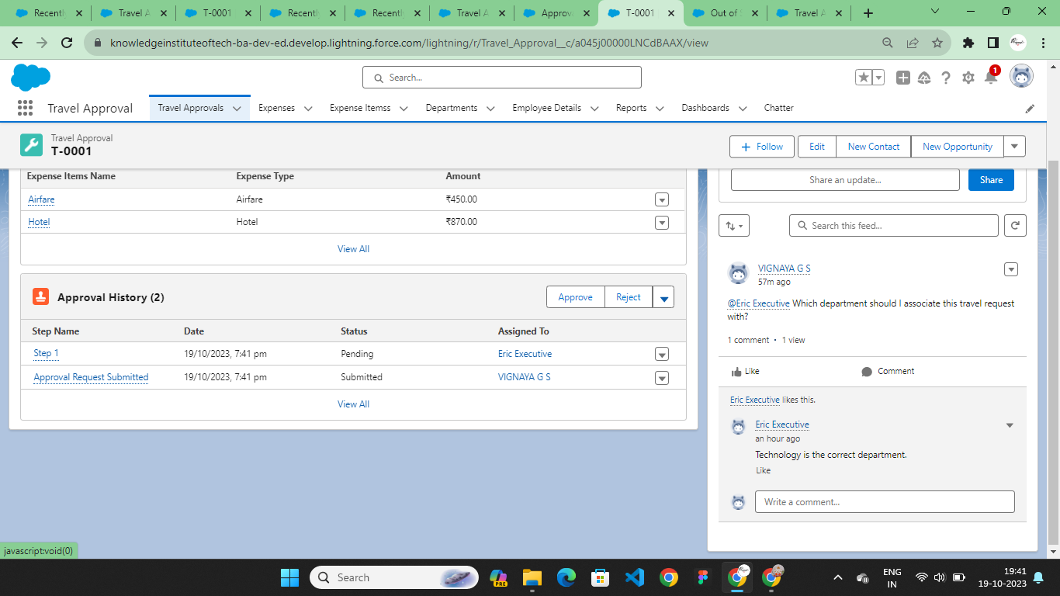
TRAVEL APPROVAL APPLICATION

Slide 11
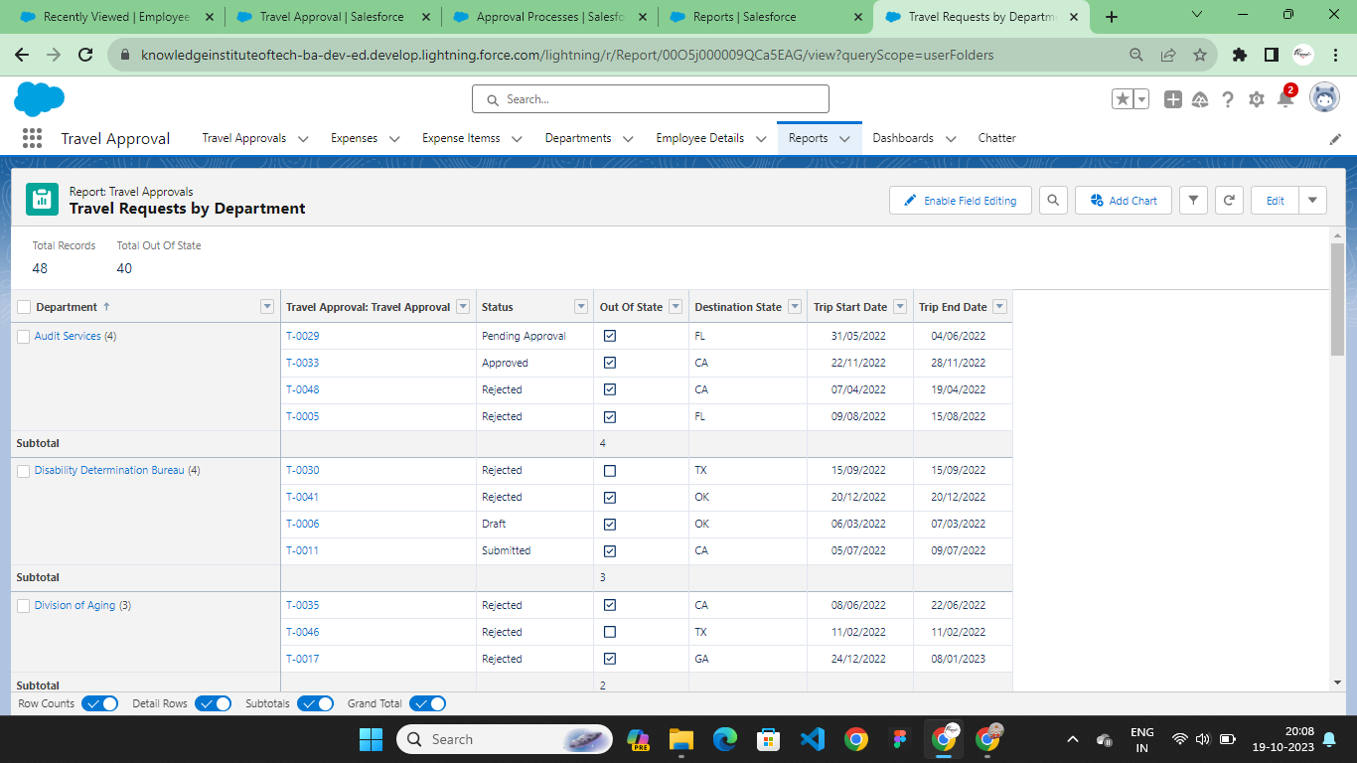
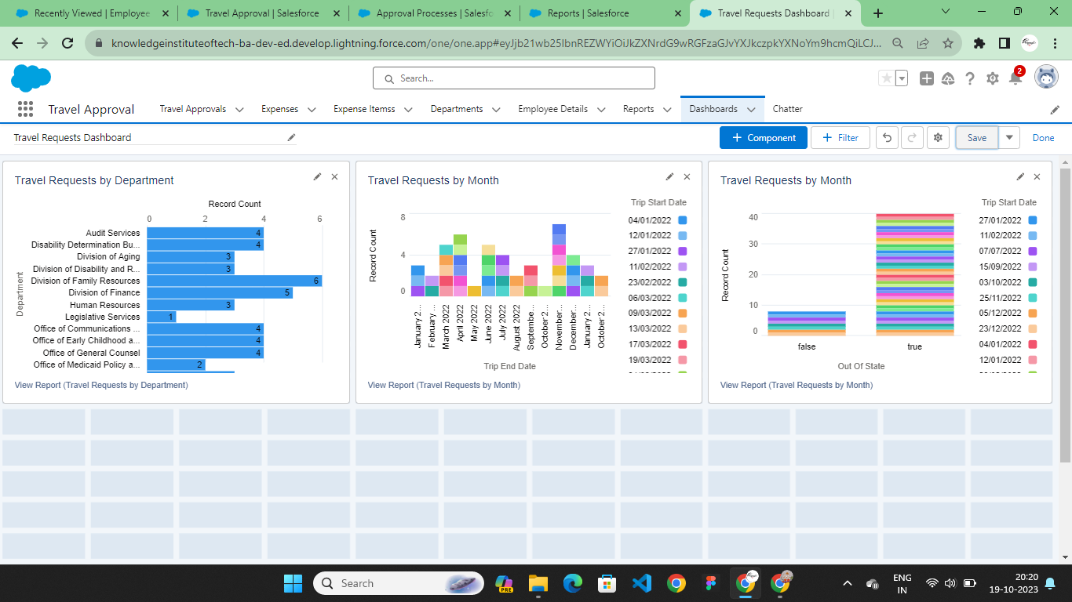
REPORTS AND DASHBOARD

Slide 12
THANK YOU

